Slide 1
Sys Admin Tool
Presented By:
(On Behalf of Group-7)
Mehedi Hasan Sabuz
ID: 171442577,
Batch: 44^{th,}
Department of CSE,
City University, Dhaka.
Supervised By:
Md. Emon Islam Rabbi
Lecturer,
Department of CSE,
City University Dhaka.

Slide 2
Contents
Introduction
Related works
Objectives
Methodology
Conclusion
References

Slide 3

Introduction
Importance of Password Management System.
Beneficial to Large and Medium size companies.
Enhanced Security.
Easy Maintenance of Server Systems.

Slide 4
Related Works
KeePassX are mainly developed to supporting Linux System.
- PAM for Linux/Unix Based System
- Desktop Based Application
Limitation
- Platform Dependent System
- Single User Application
- not reliable

Slide 5
Objectives
To develop a WEB based Multiuser supported System.
To provide a user friendly interface for the Users.
To build a Platform Independent Solution.

Slide 6
Methodology
There are three different modules to complete the whole
procedure.
User Login
Selecting a specific Server
Resetting / Unlocking Server User/Password

Slide 7
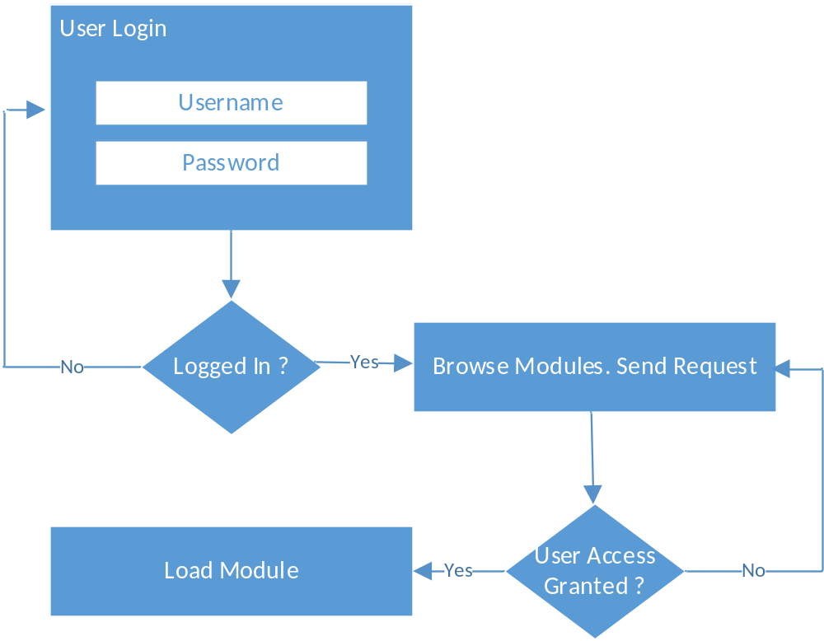
Methodology
Fig-1.1: Module Browsing

Slide 8
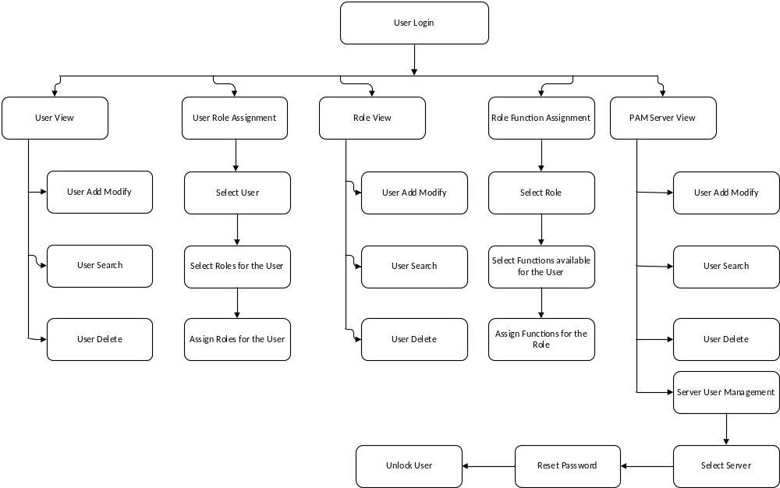
Block Diagram

Slide 9
Conclusion
User friendly interface.
Platform Independent.
Enhanced Security.
Easy to Use.
Cost minimization
Operational time reduction
Secured

Slide 10
Team Members
ID | Name | Role
171442577 | Mehedi Hasan Sabuz | Lead Technologist, Developer
171442577 | Shamim Ahmed | Developer
171442577 | Sharmin | Developer
171442577 | Rubel Patwary | QA
171442577 | Sharmin Akter | Documentation
171442577 | Jiniaur Baby | Documentation

Slide 11

The End
Thank You

